Slide 1
Understanding IBM BPM
June, 2016

Slide 2
Disclaimer
NOTICE TO THE RECIPIENT OF THIS DOCUMENT
The information contained herein is considered proprietary and confidential information of Capgemini Financial Services USA Inc. (together with its affiliates, “Capgemini”) including Capgemini Financial Services USA Inc. , and its release would offer substantial benefit to competitors offering similar services. This material includes descriptions of methodologies and concepts derived through substantial research and development efforts undertaken by Capgemini. Therefore, the use or release of the information contained in this proposal for purposes other than an evaluation of its contents as a basis for contract award is prohibited, and it is the position of Capgemini that the materials herein are not considered subject to release under the Freedom of Information Act, if applicable.
Copyright 2013 Capgemini Financial Services USA Inc. . All rights reserved. No part of this proposal may be reproduced by any means or transmitted without the prior written permission of Capgemini except with respect to copies made or transmitted internally by you for the purpose of evaluating this proposal. All copies of this proposal (or any portion hereof) and any accompanying electronic copies should be returned to Capgemini or, at Capgemini’s option, destroyed at the end of the proposal evaluation period if Capgemini is not selected.
Neither submission by Capgemini nor your acceptance of this proposal, in whole or in part, constitutes acceptance by Capgemini of any contractual terms contained in your Request for Proposal, if any, and shall not form a binding agreement between the parties. Such an agreement shall only exist upon the execution of a mutually acceptable contract by both parties. Except as otherwise set forth in such a contract, Capgemini makes no representations or warranties to you.
The term "Capgemini" appearing elsewhere in this proposal may refer to Capgemini Financial Services USA Inc. , or to one or more of its global affiliates; however, this proposal is being submitted by Capgemini Financial Services USA Inc., which is solely responsible for its contents.
© Copyright 2013. Capgemini Financial Services USA Inc

Slide 3
Agenda
What is BPM
Introduction of IBM BPM
History of IBM BPM
IBM BPM Packaging and Versions
IBM BPM Architecture
Introduction to Process Designer
Business Process Definition
Swim lanes and Team
Variables
Activities
Gateways
Coach Service
Under Cover Agent
IBM BPM events
Java Integration
EPV and ENV’s
Error Handling
Inbound Web services
Outbound Web services
Reports, Scoreboards & Dashboards
Working with Process Portal
Introduction to Admin Portal

Slide 4
What is BPM
Management of Business Processes
Systematic
Continuous Improvement of Business Effectiveness & Efficiency
Integration with Technology
Tracking & Monitoring the KPIs
Process Agility

Slide 5
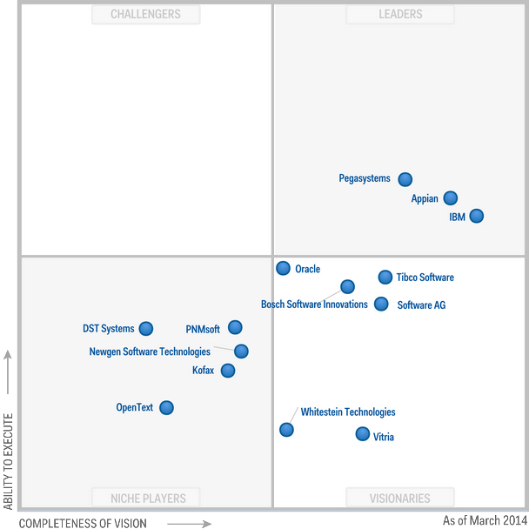
BPM Players in Industry (Gartner Magic Quadrant)

Slide 6
Introduction of IBM BPM
IBM Business Process Manager (IBPM) provides a platform on which Business Processes can be described, implemented, executed and monitored.
IBPM is a single product that brings together all the features and functions of both WPS and WLE in one environment.

Slide 7
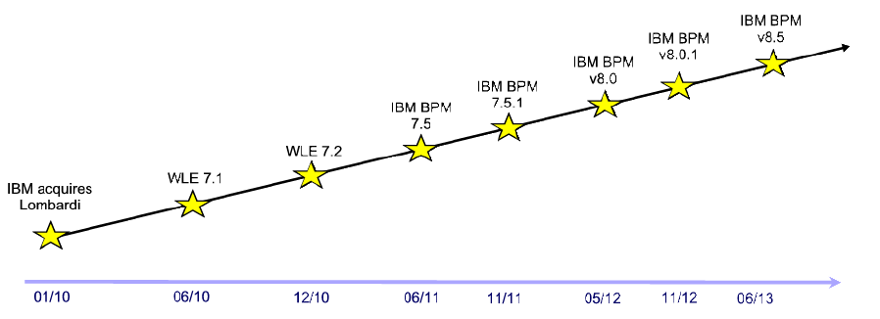
History of IBM BPM
TeamWorks was re-named as WebSphere Lombardi Edition (WLE)
First release in June 2010 with the 7.1 release
December 2010, the WLE 7.2 version hit the streets

Slide 8
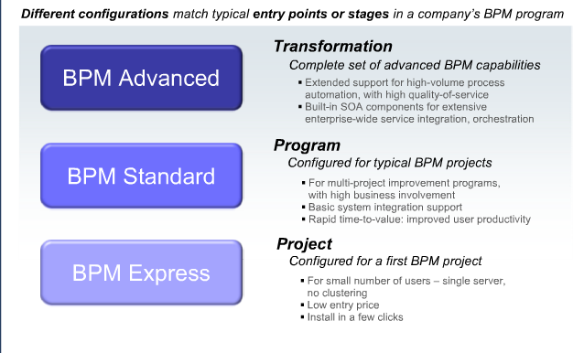
IBM BPM Packaging And Versions

Slide 9
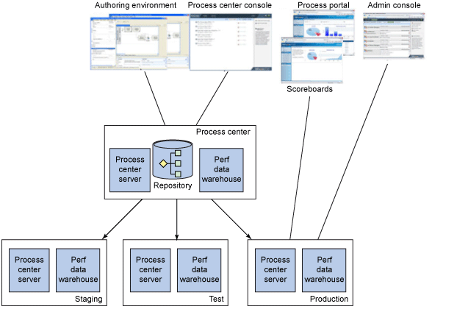
IBM BPM Architecture (Component View)

Slide 10
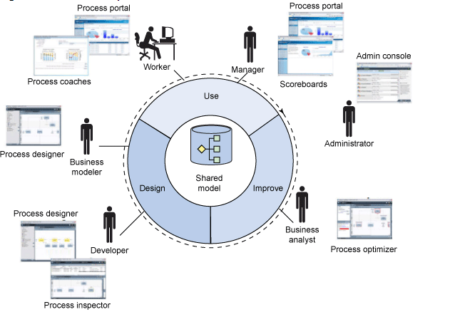
IBM BPM Architecture (Usage View)

Slide 11
What is Process Designer (Lombardi)
IBPM Process Designer (PD) is the development time tooling used to
design,
model and
build processes.
Eclipse based but has a very non-Eclipse like skin applied over it.
IBPM PD can be downloaded from the IBPM Process Center and installed on a user's Windows based workstation.
IBPM PD connects to a single instance of a Process Center and there is no exposed ability to change which Process Center instance against which it should communicate.
At a high level IBPM PD allows us to describe business processes using the BPMN notation. Processes are "drawn" visually on the screen canvas and the technical skills needed to achieve this task are as low as can possibly be made.

Slide 12
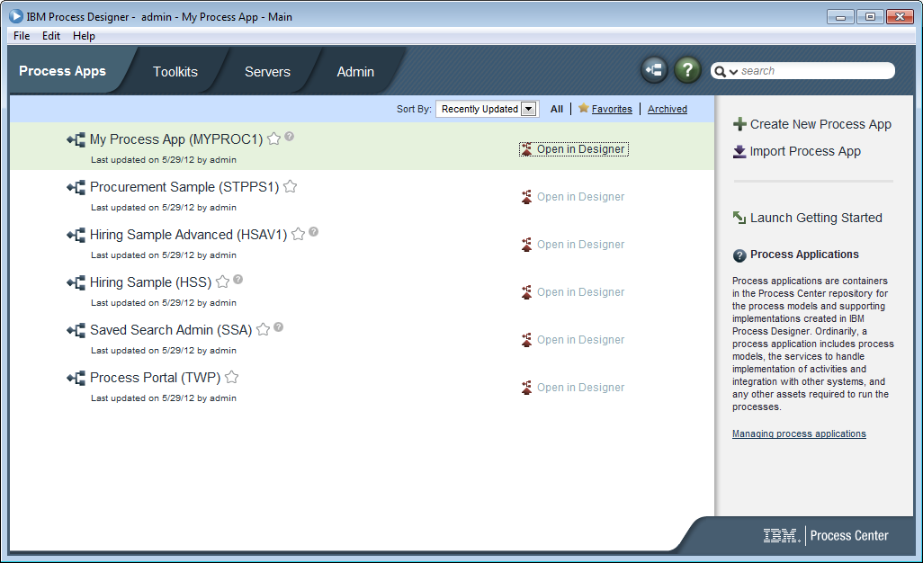
Front page of Process Designer

Slide 13
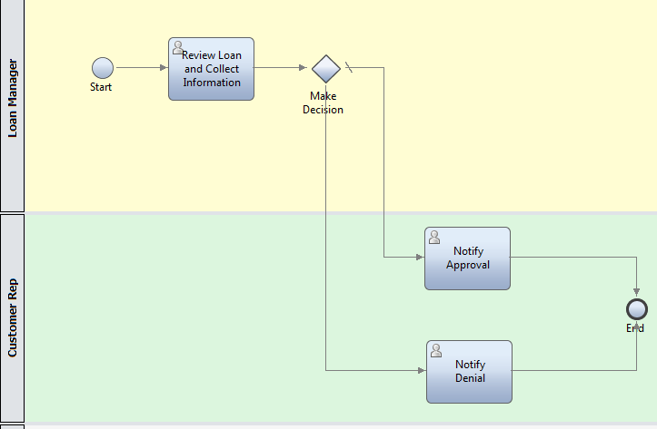
Business Process Definition (BPD)
Business Process Definition (BPD) is the core of an IBM BPM solution.
BPD represents the model of the business process
Diagram that represents the overall view and flow of the process.
Constructed by Business Process Analyst
Conforms to the industry standard Business Process Model and Notation (BPMN) format.

Slide 14
Swimlanes And Teams
Logical representation of various roles or teams involved in Business Process
An Business Activity belong to one role or one swimlane only
Team is logical group of users assigned to one logical role
Typically a team is assigned to one swimlane

Slide 15
Variables

Slide 16
Activities

Slide 17



Gateways
Gateways, Conditionals and Joins
Gateways are decision points in the BPD. When reached, an expression is evaluated and based on the outcome of that expression, control flows in different paths. In IBPM, the JavaScript language is used to evaluate the decision's outcome.
The simplest gateway is called the Exclusive Gateway. The outcome of the expression is a Boolean (true or false) outcome. The output of the decision is always that a single path is taken.
The second type of gateway is the Parallel Gateway. It does not have an expression associated with it. When reached, all the paths associated are followed in parallel. Each followed path is termed a branch.
The third type of gateway is called the Inclusive Gateway. Like the simple decision, there are expressions involved but in this case, control can flow from this primitive in one or more directions assuming multiple conditions evaluate to true.

Slide 18
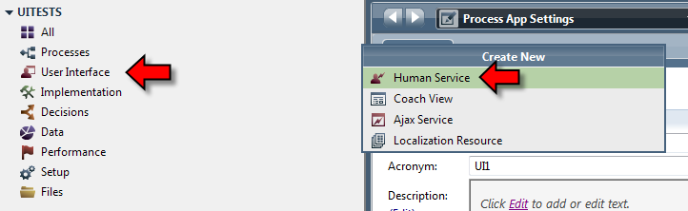
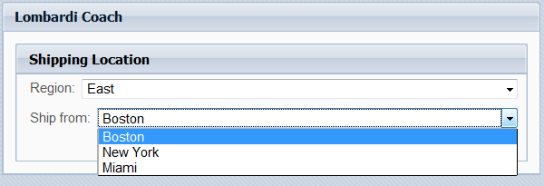
Human (Coach) Service
Coaches represent user interface in IBPM
Human Service may contain more than 1 coaches
On Execution creates a Task for a user / team associated to that task

Slide 19
IBM BPM Events

Slide 20
Java - SQL Integration & EPV-ENV

Slide 21
Error Handling

Slide 22
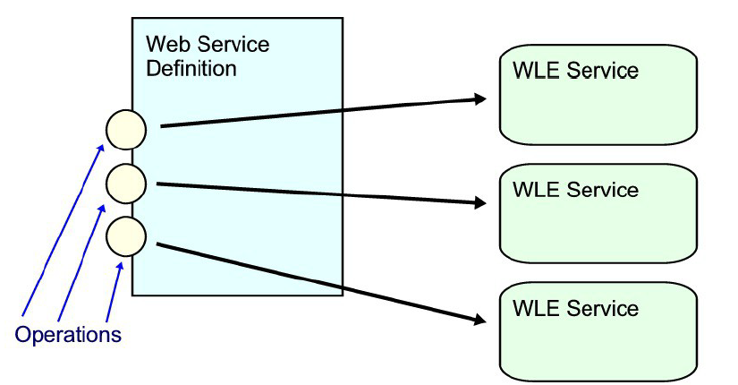
Inbound Webservices
An inbound Web Service is the notion that a IBPM solution can "advertise" or "expose" itself as a Web Service allowing it to be called from an external Web Service caller or client. In a typical Web Service, there can be multiple "operations" defined on a single service. IBPM's mapping to the concept of Web Services is that when a web service definition is made, one or more operations may be defined. For each operation defined on that Web Service, an IBPM Service definition is mapped to it.
For each operation, there is a reference to a corresponding IBPM Service definition.

Slide 23
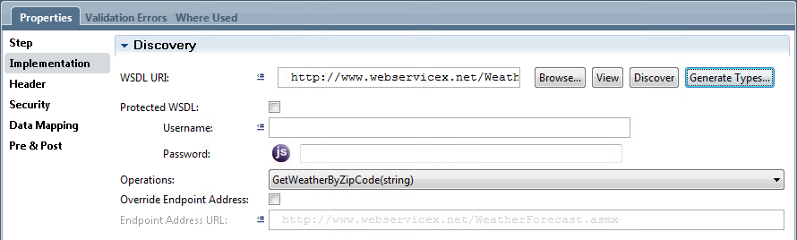
Outbound Webservices
One of the more common ways that a service is exposed is through the technology known as WebServices. Web Services is an encoding of an XML document sent over an HTTP transport. WebServices is an open an industry standard composed of a number of key specifications including SOAP and WSDL.
The description of an external Web Service is commonly described in a Web Services Definition Language (WSDL) file. In order for IBPM to know how and where to call a Web Service, we need to make the WSDL document that describes that service known. A common convention is that when a Web Service is published a URL can be supplied which will return the WSDL for that WebService.
http://localhost:9080/MyProject/MyWebService
http://localhost:9080/MyProject/MyWebService?WSDL

Slide 24
Reports , Scoreboards & Dashboards
IBM BPM provides the following options for reports:
Out of the box scoreboards Enable you to analyze personal performance, team performance, business process performance, and SLA violations with minimal configuration. These scoreboards are available by default in Process Portal. Reports Enable you to analyze business data specific to your processes. You can define the variables to track and create the customized reports to query your tracked data in Process Designer. Users can view the resulting report scoreboards in Process Portal or any browser. The ad-hoc report wizard in the Designer provides a way to quickly configure and publish a report Or you can configure a more advanced report
IBM BPM also enables you to create ad-hoc reports in the Process Portal.
Reports generated in third-party tools You can query the IBM BPM Performance Data Warehouse and extract data using another tool such as Microsoft Access.
Using out of the box scoreboards
My Performance: Members of the All Users participant group
My Team Performance: Members of the Managers participant group
Process Performance: Members of the Process Owner participant group
SLA Overview: Members of the Process Owner participant group

Slide 25
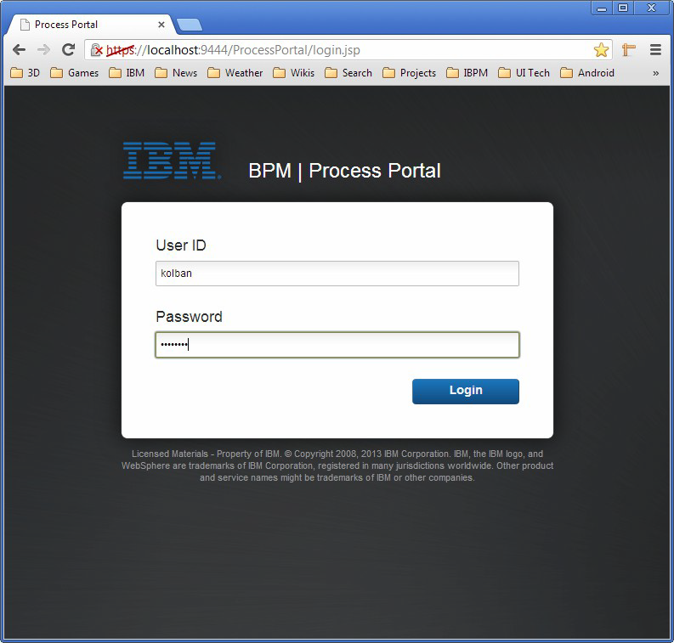
Working with Process Portal
Process Portal is the IBM supplied environment from which users can interact with processes managed by IBM BPM. Process Portal is a browser based framework for interacting with process instances.
It can be reached at the following URL: https://localhost:9444/ProcessPortal/login.jsp

Slide 26
Introduction to Admin Portal
The Process Admin Console is a web based interface for system administrators. It provides a wealth of functions for system operations.
Manage Caches
Task Cleanup
User Management
User Management Working with users: Process Admin - User Management
Group Management Working with global groups and group membership: Group Management
Bulk User Attribute Assignment Setting attributes on user definitions: Bulk User Attribute Assignment
User Synchronization
Monitoring
Instrumentation
Process Monitor

Slide 27
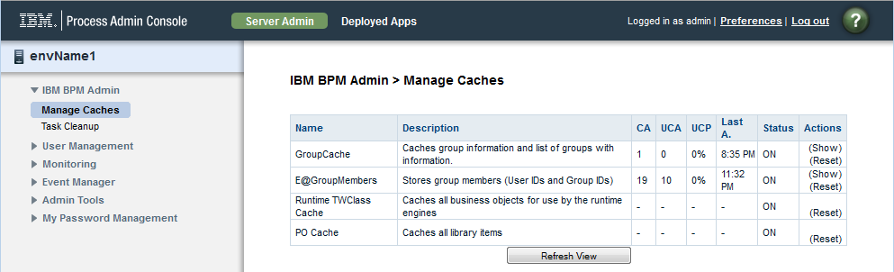
Introduction to Admin Portal
Event Manager
Monitor
EM JMS Error Queue
Manage EPVs
My Password Management
Change Password
Saved Search Admin

